Slide 1

Data Analytics for Better Business Decision
Problem Statement:
Understanding Career Aspiration of Gen-Zs
Presented by Varsha Zagade

Slide 2
Learning Roadmap Success
Introduction to the problem statement and researching about it to get a better understanding
Approaching the problem statement and creating a Business Research Document.
Collecting the data and cleaning It using SQL.
Analysis of Business questions using SQL.
Creating Focus area Dashboards.
Creating a comprehensive Dashboard.
The Final Insight

Slide 3

For the problem statement, we will be going to discuss about Generation Z. The generation which was born between 1995 to 2012 in the era where technology was introduced, internet started penetrating, and there was social and economic change in the world. This generation is persistent, rebellious and ambitious towards future. These people want to make impact on this world more than any other generations.
Their characteristics include Digital natives, tech-savvy, diverse, socially conscious, short attention span, global perspective, independent thinkers, flexible and adaptable.
However, in the corporate world, Gen Z’s are not understood by the Employers, as a result of which both faces problems at workplace. So, in this project we will understand the gap and help the recruiters get the right people at right place in the organizations.
Introduction to the problem statement and researching about it to get a better understanding.

Slide 4
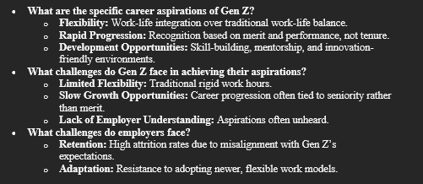
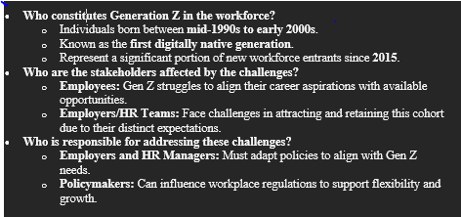
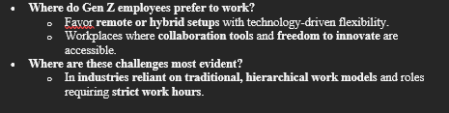
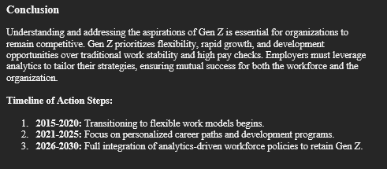

Approaching the problem statement and creating a Business Research Document

Slide 5
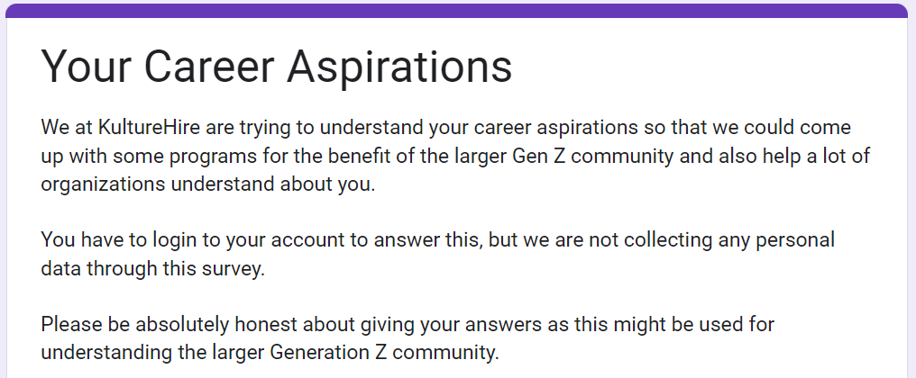
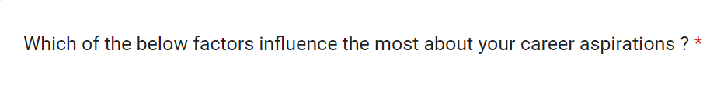
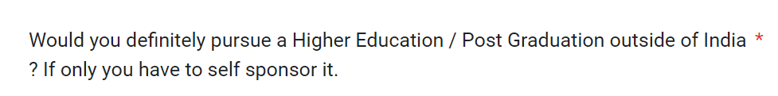
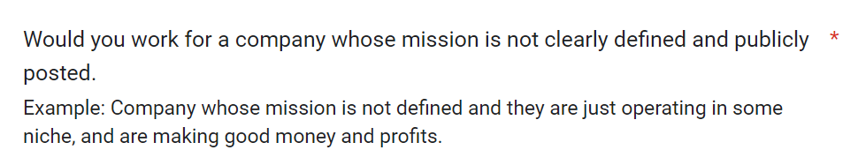
Data Collection
Data collection improves customer experience and drives better decision-making and overall growth for businesses across the board.
For our problem statement we gathered data from the Gen-Zs through platforms like LinkedIn, Instagram, etc.

Slide 6
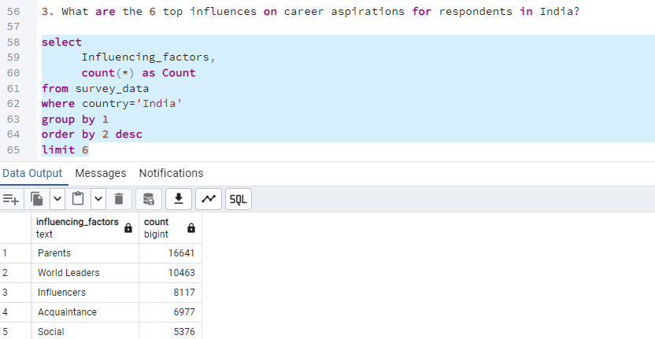
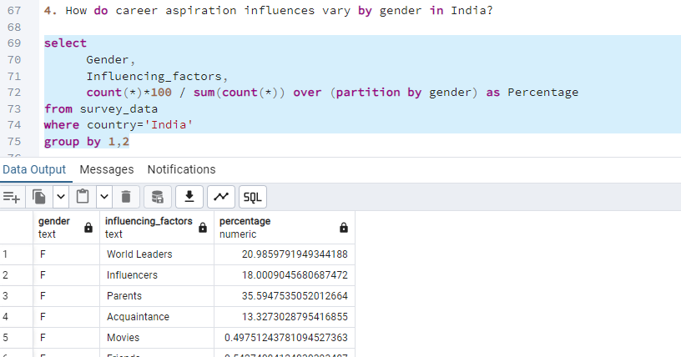
Cleaning the Data And Answering the Business Questions
Data Cleaning is the important step in Data Analytics.
Used MySQL Server Workbench to perform data analysis. The data was imported from CSV and XLSX files into the server.
Using SQL queries to clean, analyze and explore data and focused on business-related questions.we have included some key code snippets along with their corresponding outputs to demonstrate our approach and results

Slide 7
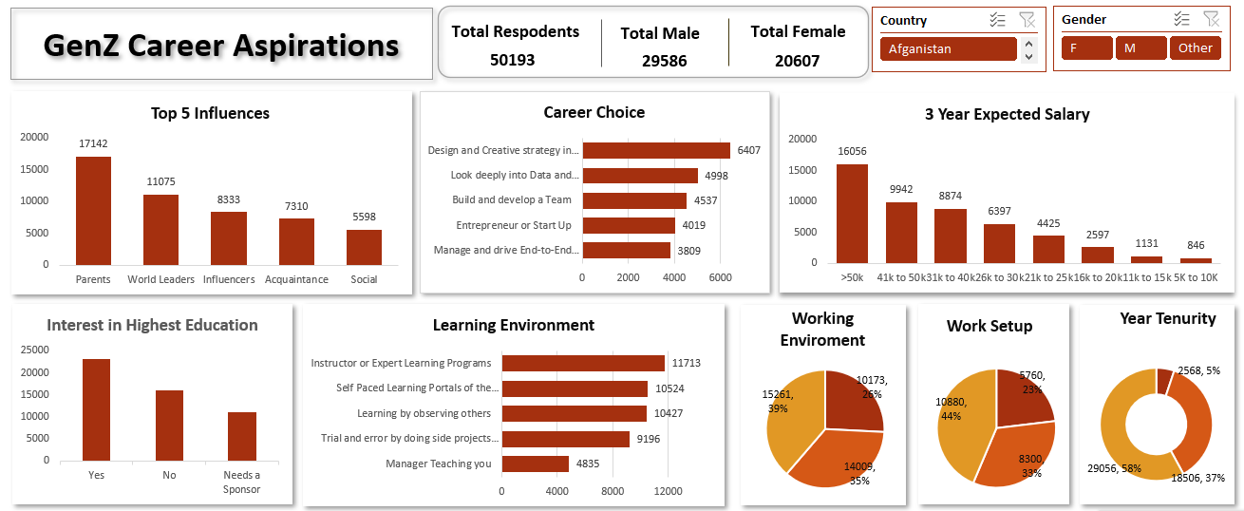
A Comprehensive Dashboard

Slide 8
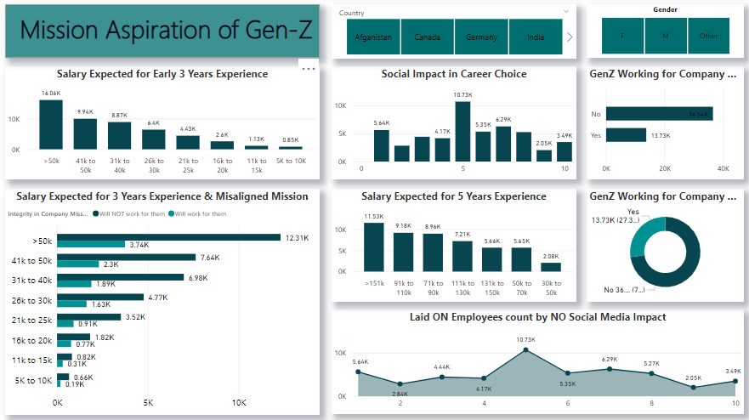
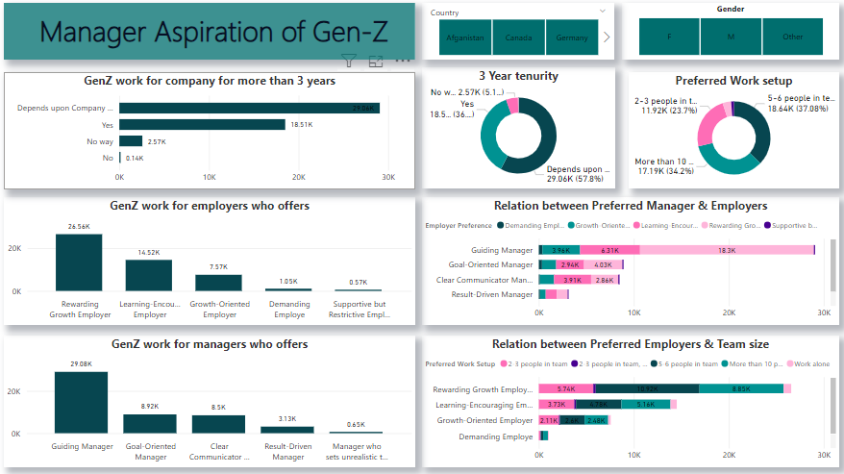
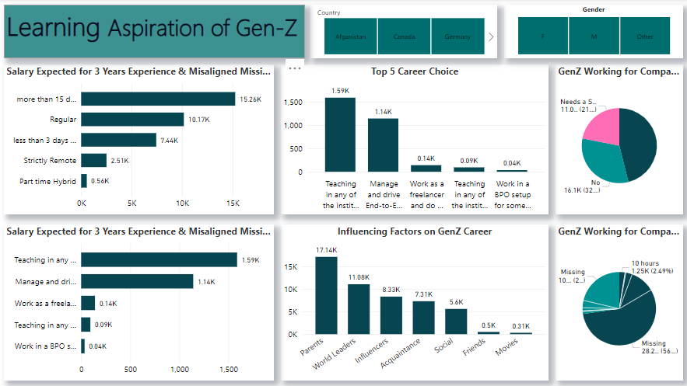
Functional Dashboards using PowerBI
We made three focused dashboards along with one comprehensive dashboard. These three dashboards were based of 3 aspects :
Mission Expectation by Gen Z
Learning Aspirations of Gen Z
Manager’s Expectation by Gen Z

Slide 9
From this dashboard, Most Gen-Z employees with three years of experience expect salaries ranging from ₹41K to ₹50K.
They are willing to accept up to ₹12K higher salaries if the company’s mission aligns with their personal values.
A significant number of Gen-Z employees (13.73K) prioritize working for companies with a positive social impact. On the other hand, organizations without a clear social mission may face challenges in attracting and retaining this talent pool.

Slide 10
From this dashboard ,A significant number of Gen-Z employees (18.5K) aspire to stay with companies for more than three years.
They prefer working in small to medium teams of 2-6 people and are most drawn to workplaces that offer growth and learning opportunities.
Guiding managers are the top choice, with 29K responses favouring this style, followed by managers who are goal-oriented and clear communicators.
Demanding or restrictive management styles have very little appeal, reflecting a preference for supportive and empowering leadership.
along with one comprehensive dashboard. These three dashboards were based of 3 aspects :
Mission Expectation by Gen Z
Learning Aspirations of Gen Z
Manager’s Expectation by Gen Z

Slide 11
From this dashboard ,Teaching and management are the most preferred career paths, with flexible work arrangements and hybrid options being highly valued.
A strong emphasis on work-life balance is evident, as most individuals prefer at least 15 or more days off.
Parents play the most significant role in influencing career choices, with 17.1K responses indicating their impact. World leaders and influencers also shape decisions, while traditional media like movies has minimal influence.

Slide 12
Conclusion
Gen-Z values flexible work arrangements, work-life balance, and companies with a strong social mission.
They prefer small teams, growth opportunities, and supportive, goal-oriented management.
Loyalty is important to Gen-Z, with many aspiring to stay with companies for the long term.
Parents and world leaders are key influences in their career decisions, while traditional media has minimal impact.
Gen-Z’s salary expectations align with their experience, and they adjust their expectations realistically over time.

Slide 13
THANK YOU

